Slide 1

Logo
Search
Playlist
Credits
Group names
GitHub url
Top Genres
Top Artists
Most Popular Songs
Footer

Slide 2


Logo
Search
Playlist
Credits
Basic Song Search
Browse / Search Results
Title
Type here
Title
Artist
Year
Genre
Artist
Pick one
Add
Genre
Pick one
Clear
Filter
Footer

Slide 3
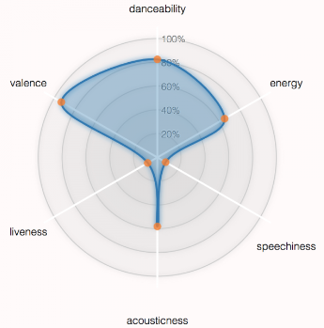
Logo
Search
Playlist
Credits
Song Information
Radar Chart
title, artist name, artist type, genre, year, duration
Analysis data:
bpm,
energy,
danceability,
liveness,
valence,
acousticness,
speechiness,
popularity
Footer

Slide 4
Logo
Search
Playlist
Credits
Playlist Details
# songs, popularity ranking
Clear Playlist
Title
Artist
Year
Genre
Remove
Footer

